Slide 1

Laptop Price Prediction
- Mohammed Ismail

Slide 2
Now adays working professional and students who wants to buy new laptop and he know all feature configurations then our website will surely know the configuration and will predict price If one user gives desire configuration of laptop our model will predict the price according to the configuration
Objective

Slide 3
Steps
Data Gathering
Data Cleaning
Exploratory Data Analysis ( EDA )
Feature Engineering
Modelling

Slide 4
Data Geathering
Python Library used :
Selenium, Beautifullsoup, pandas
Website :
www.smartprix.com/laptop

Slide 5
Data Cleaning
Rows: 1303 Columns: 12

Slide 6
Data Cleaning
No Duplicate Values
Missing Values added as NAN
Unwanted values , Columns added
Values shifted to next feature

Slide 7
Data Cleaning
So Much information in a column we need to do Feature Engineering
Eg .
Memory : '128GB SSD’
ScreenResolution : 'IPS Panel Full HD / Touchscreen 1920x1080’

Slide 8
Data Cleaning
So Much information in a column we need to do Feature Engineering
Eg .
Memory : '128GB SSD’
ScreenResolution : 'IPS Panel Full HD / Touchscreen 1920x1080’

Slide 9
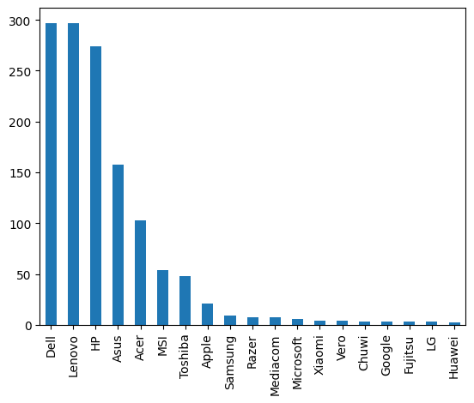
Exploratory Data Analysis (EDA)
Dell, Lenovo, Hp, Asus, Acer, Msi, Toshiba,Apple are having more laptop than other
( Dell, Lenovo, Hp are Leading )

Slide 10
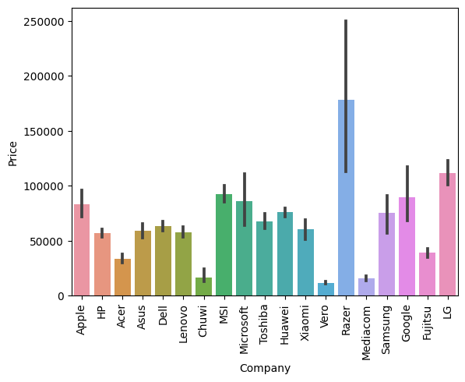
Exploratory Data Analysis (EDA)
razor has costly laptop among all
LG, google, Microsoft, apple and MSi are costly one In budget laptop we can see (HP, Acer, Dell, Lenovo)
Clearly, we can see here is Variation
prices Varies on Company
laptop buying preference depends on laptop company

Slide 11
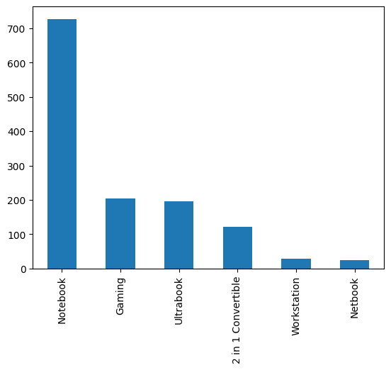
Exploratory Data Analysis (EDA)
6 type of laptop are there
Notebook is High count(due to budget range)

Slide 12
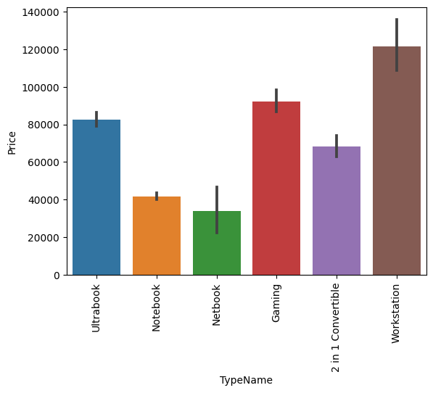
Exploratory Data Analysis (EDA)
Most costly is Workstation then Gaming then Ultrabook.
its Clearly shows that price will depend on type of laptop

Slide 13
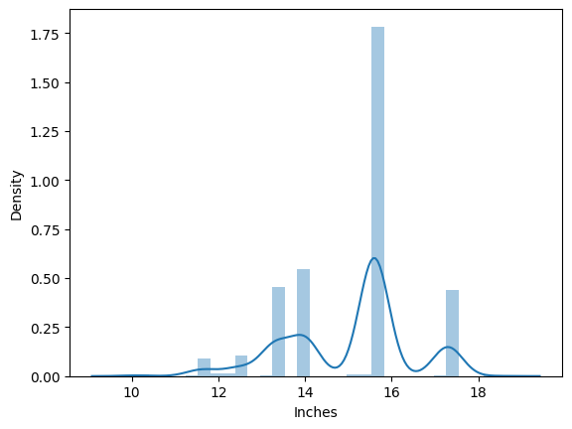
Exploratory Data Analysis (EDA)
most laptop comes under 15-16 inches laptop

Slide 14
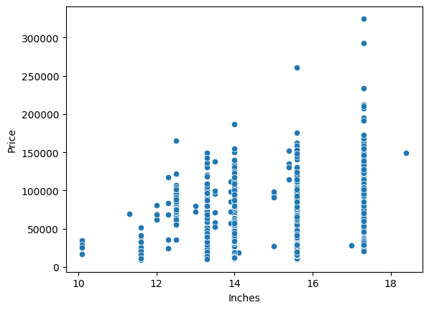
Exploratory Data Analysis (EDA)
size increases price will also increases.
price also depend on size (inches) not strong relationship but their is relationship

Slide 15
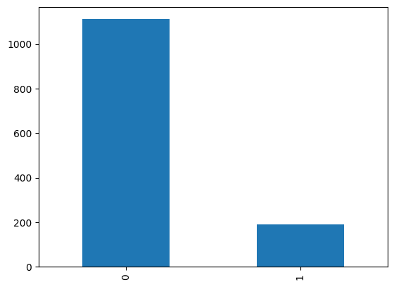
Exploratory Data Analysis (EDA)
here we can see more than 1000 No Touchscreen Laptops
Touchscreen laptop are around 200

Slide 16
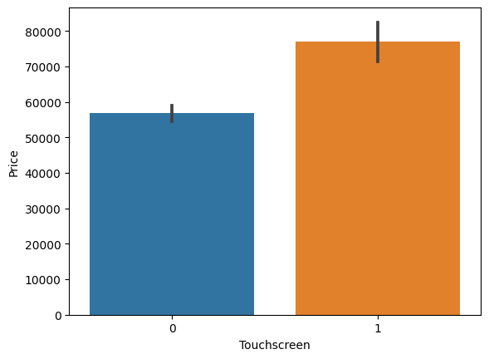
Exploratory Data Analysis (EDA)
Laptop with Touchscreen price is high as compare with no touchscreen
This is imp feature

Slide 17
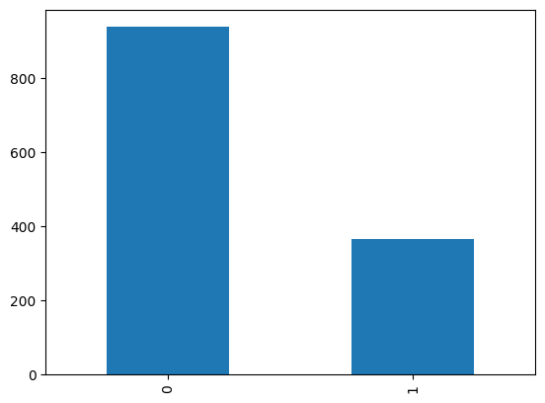
Exploratory Data Analysis (EDA)
Laptop with No IPS display are 900
Laptop with IPS Display 400

Slide 18
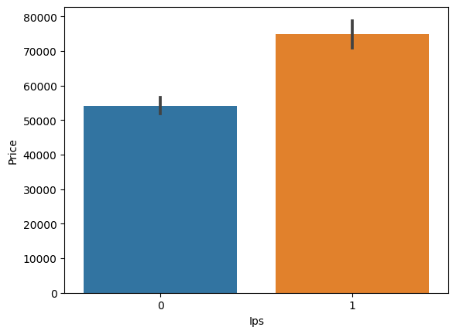
Exploratory Data Analysis (EDA)
It has relationship with price
Laptop with IPS Display is price is high

Slide 19
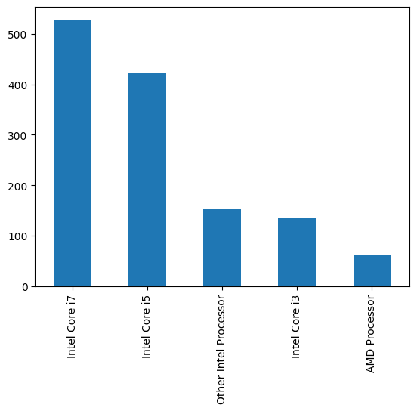
Exploratory Data Analysis (EDA)
i7 has more than 500 laptop
i5 has more than 400 laptop
AMD has less than 100 laptop

Slide 20
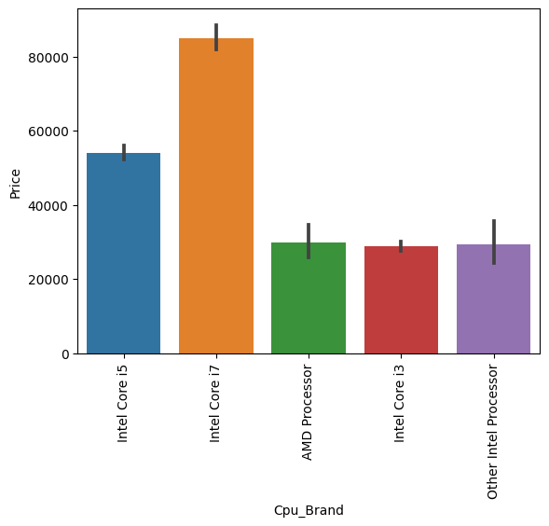
Exploratory Data Analysis (EDA)
I7 & i5 is more costly (80k,50k)
AMD and other similar price less than 40k.
This is also important column

Slide 21
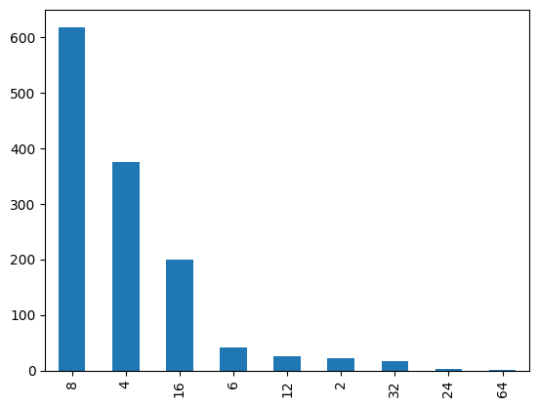
Exploratory Data Analysis (EDA)
8GB RAM laptop are more than 600
surprisingly 4GB RAM is still in more demand ( budget friendly)
16 GB RAM is around 200

Slide 22
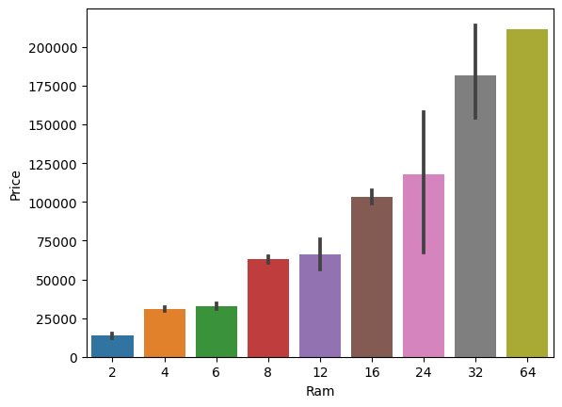
Exploratory Data Analysis (EDA)
RAM has Linear relationship with Price
Ram increases Price will increase
Ram Is Very Imp Column

Slide 23
Exploratory Data Analysis (EDA)
Now we will Focus on most Difficult column in this dataset to clean { Memory }
Create 4 new column from this single column as it has so many information in it.
Column Name:
HDD : (1 TB = 1000GB)
SSD
Flash Storage
Hybrid

Slide 24
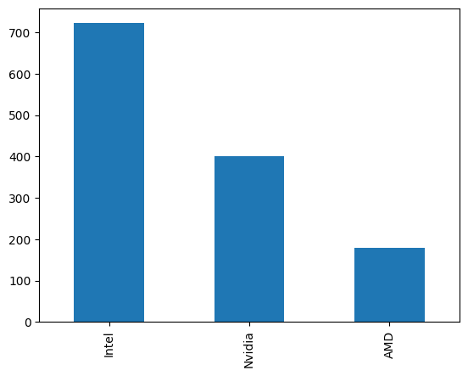
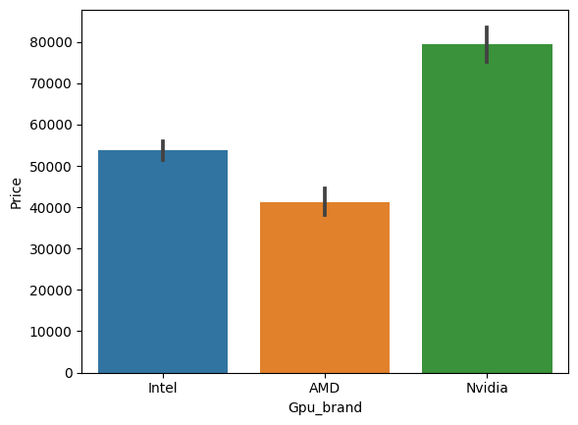
Exploratory Data Analysis (EDA)
Intel GPU laptop Has more Because of Budget friendly
Nvidia is the costliest
AMD is the Budget friendly

Slide 25
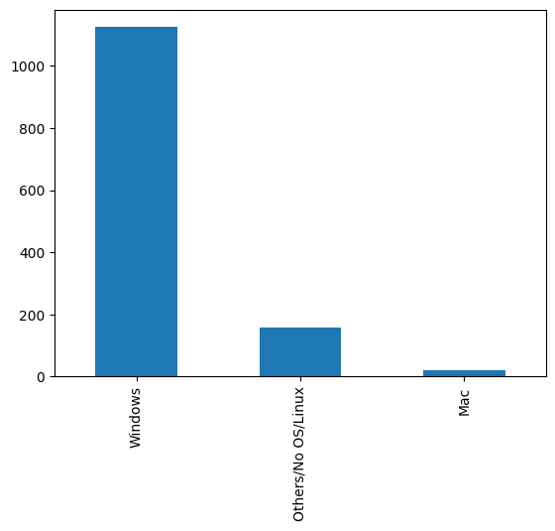
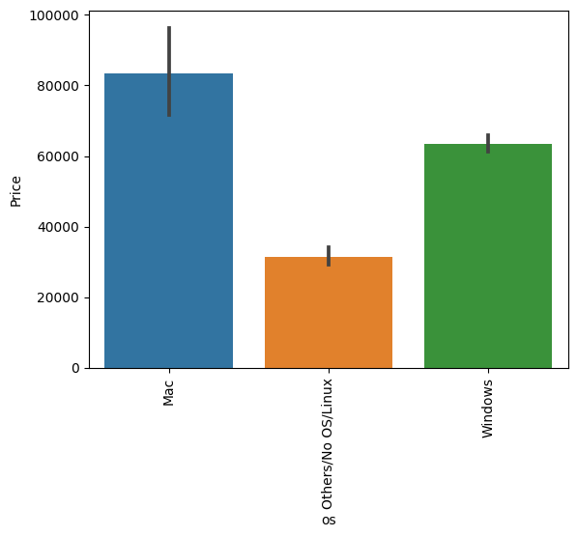
Exploratory Data Analysis (EDA)
Windows Laptop are more than 1000
Mac Laptop are more costlier more than 80k
Windows laptop price are more than 60k

Slide 26
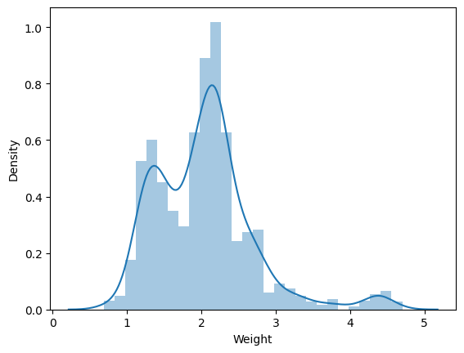
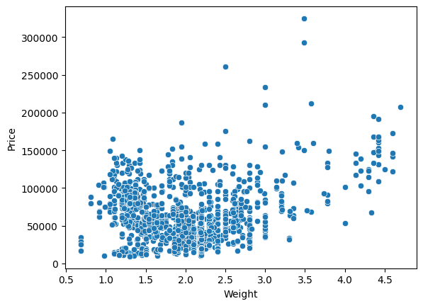
Exploratory Data Analysis (EDA)
its a continuous column
its fairly normal distribution
more towards bimodal most of the laptop in 1.5 to 2 kg
Slight Linear relationship

Slide 27
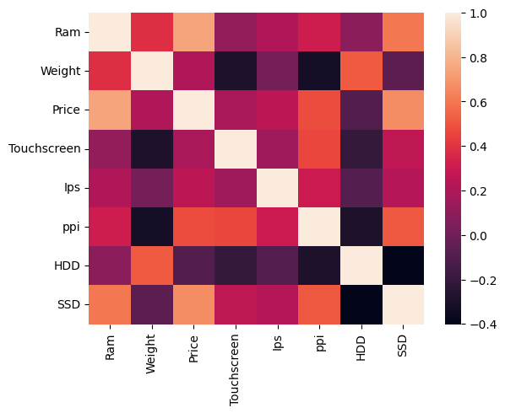
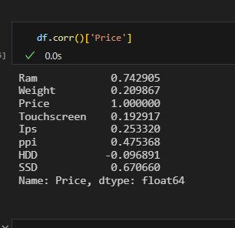
Exploratory Data Analysis (EDA)
correlation is fine between each column we are not getting any whitish color other than price
also, we can see slight relation with weight and HDD column, but we need both column it’s require

Slide 28
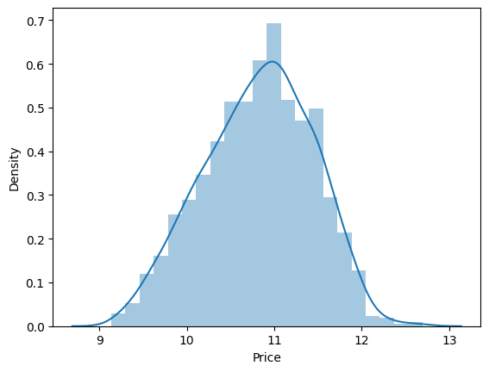
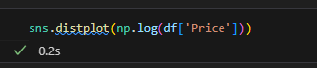
Exploratory Data Analysis (EDA)
price column is slightly skewed, so we need to convert into normal using Log Transformation

Slide 29
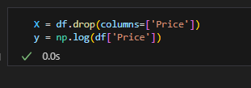
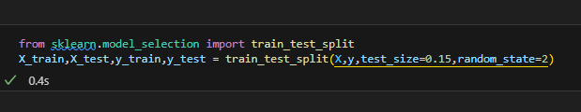
Model Building
Divide data into Train test split
Test size is 15%

Slide 30
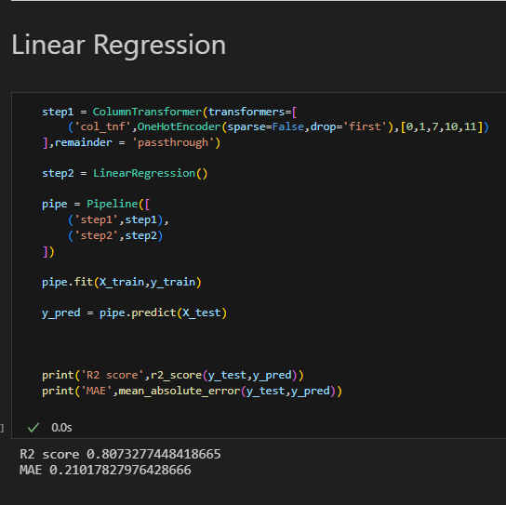
Exploratory Data Analysis (EDA)
Linear Regression
With Encoding in one pipeline
R2 score is 0.80
MAE is 0.21

Slide 31
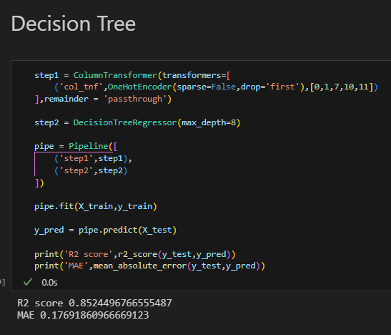
Exploratory Data Analysis (EDA)
Decision Tree Regressor
With Encoding in one pipeline
R2 score is 0.85
MAE is 0.17

Slide 32
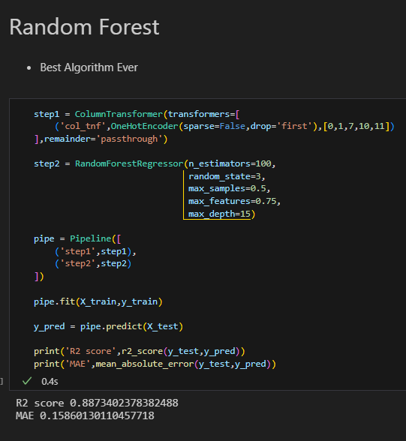
Exploratory Data Analysis (EDA)
RandomForest Regression
With Encoding in one pipeline
R2 score is 0.88
MAE is 0.15
Random Forest Regressor is giving us good result we will finalized this model for our project

Slide 33
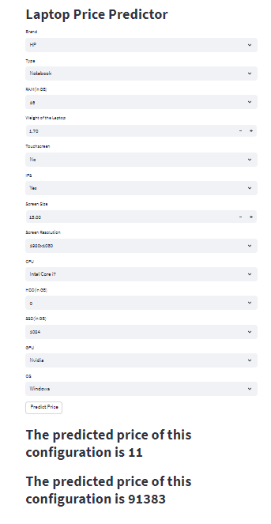
WebApp
Web app using Streamlit library
All Feature need to be added
It will predict the similar price

Slide 34
Thank You

